Slide 1
Kushi Fusako “Memoirs of a Declining Ryukyuan Woman”& “In Defense” (1932)
久志冨佐子
滅びゆく琉球女の手記

Slide 2
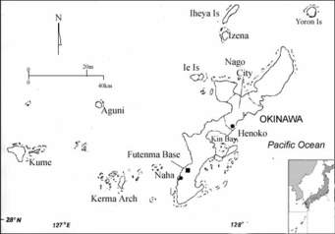
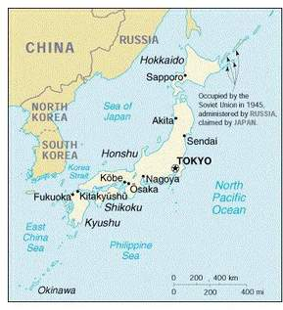
Maps

Slide 3

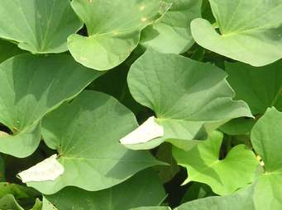
Sweet potato

Slide 4
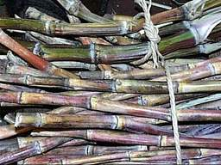
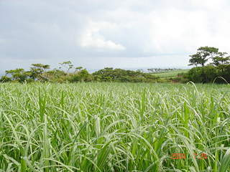
Sugarcane

Slide 5
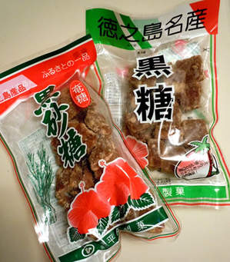
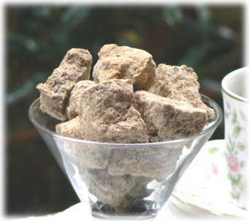
Brown sugar

Slide 6
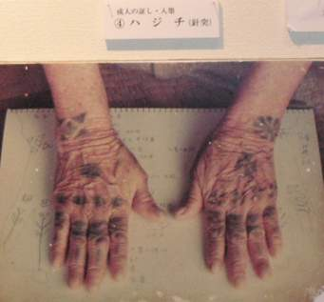
Tattoo

Slide 7

Sanshin

Slide 8
Keywords
Slip of the Pen Incident, 1932
Phantom author
The Human Pavilion Incident, 1903
“decline” “Ryûkyû”
US Immigration Act of 1924, emigration ban
Racial hierarchies
Eugenics
“passing”
Family register
Karl Busse
American jazz

Slide 9
Discussion Questions
Describe the story’s structure. How would you characterize beginning, middle, and end?
What passages or themes connect this story to those found in “Officer Ukuma”?
Analyze the ending of the story. How does it differ from what precedes it?
How does Kushi Fusako manage to defend herself against her critics? What does her defense teach us?

